Slide 1
Ames Housing Price Analysis
ALY 6040: Data Mining Applications
Team Participants:
Nitika Bhatia
Pooja Shirke
Sheith Sadeddin
Sreyluch Seang
Zixin Meng

Slide 2
Data Understanding
About the Data
Data Source
This Kaggle data set describes the sale of individual residential property in Ames, Iowa from 2006 to 2010.
2930 observations with 79 explanatory variables (23 nominal, 23 ordinal, 14 discrete,19 continuous)
Mean house sale prices: 180921.2
Standard Deviation: 79442.5
Price Range: 34900 - 75500
Observations and Variables
Target Variable: House Sale Prices

Slide 3
Business Questions
Objective of our Analysis
01
What is the distribution of House Sale Prices based on quality ratings?
02
What are the median House Sale Prices for different building types?
03
Which neighborhoods are populated with better condition houses?
04
Whether houses with Central Air are more expensive than without AC?
05
What can be the potential cost of a home?

Slide 4
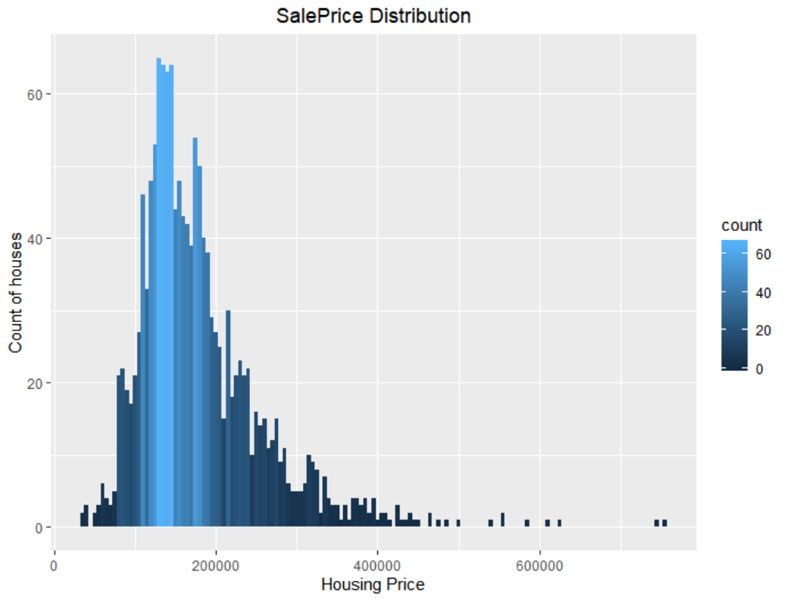
Descriptive Analysis: Target Variable
Parameter | Value
Mean | 180921.2
Std Dev | 79442.5
Median | 163000
MAD | 56338.8
Min | 34900
Max | 755000
Range | 720100
1st Quar | 129975
3rd Quar | 214000
Skew | 1.88
Kurtosis | 6.5

Slide 5
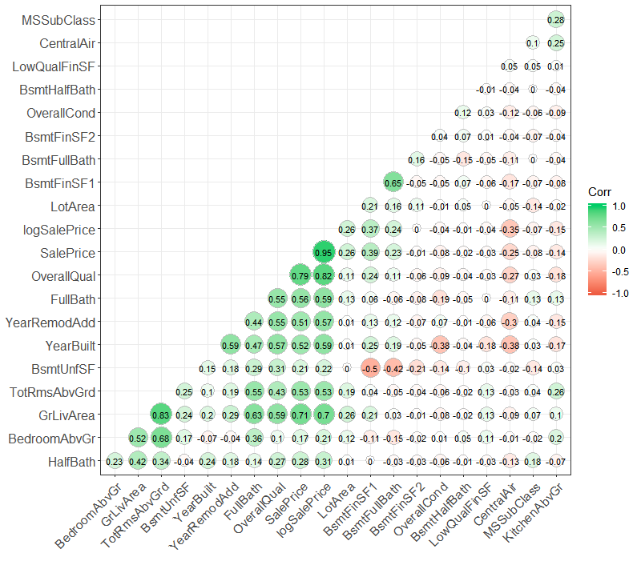
Correlogram
Correlation between the numerical variables of the dataset.
Sales price has a strong positive correlation of 0.79 with Overall Quality of the Houses.

Slide 6
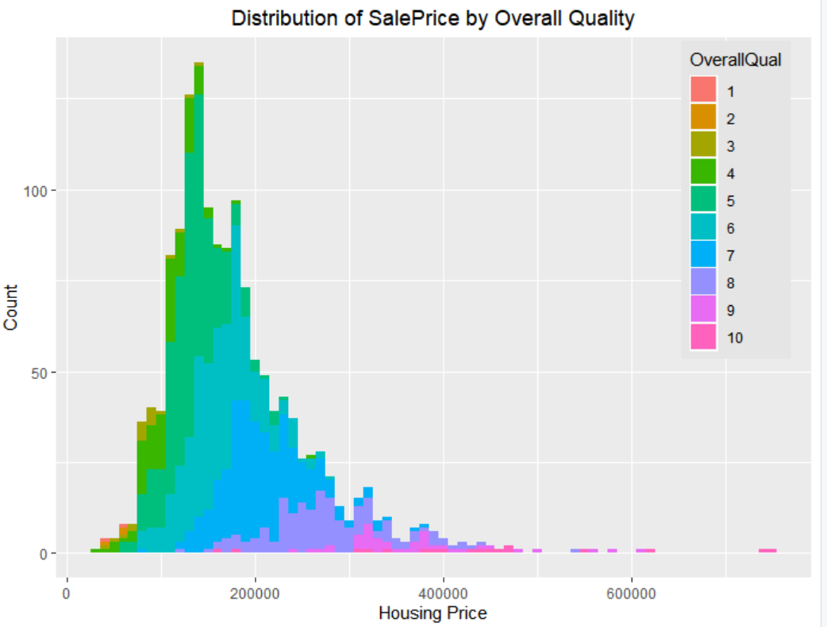
Distribution of Sale Prices based on Quality Ratings
Sale Prices – 0 to 100000
Houses with Quality ratings between 1 to 3 dominate this range
Sale Prices – 100000 to 300000
Houses with Quality ratings between 4 to 6 dominate this range
Sale Prices – 300000 to 800000
Houses with Quality ratings between 7 to 9 dominate this range

Slide 7
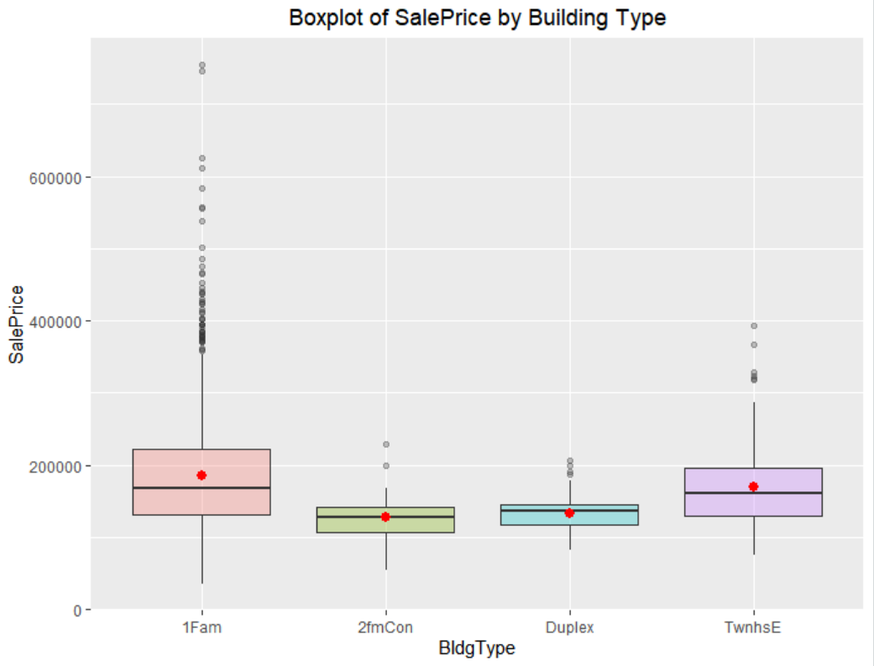
Median of House sale prices based on building type
$167900
Single Family Home
$127500
Condos
$135980
Duplex
$162000
Townhouse

Slide 8
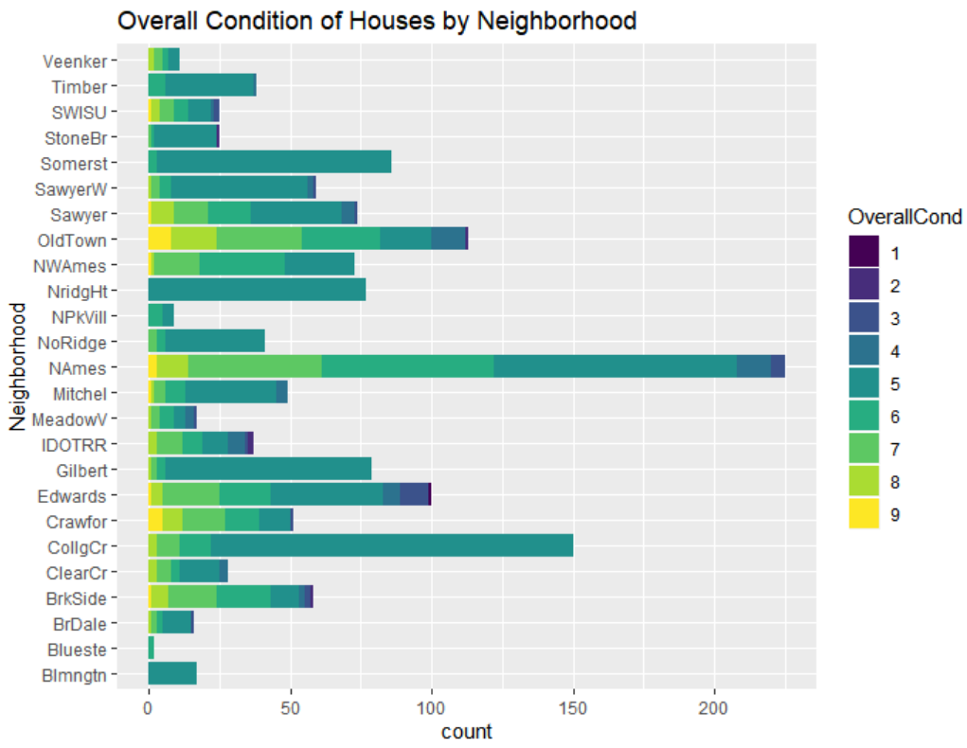
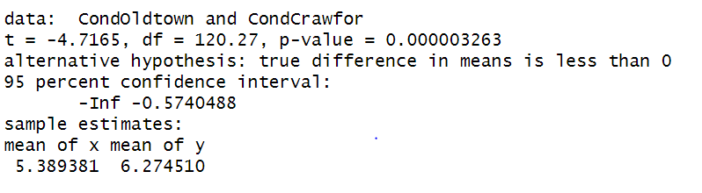
Condition of Houses based on their neighborhood
Comparison of Old Town and Crawfor Neighborhoods
Used Hypothesis testing to check whether the average condition of houses in Old Town is better than the ones in Crawfor at 95% confidence interval
Results:
Null Hypothesis rejected
Overall Condition of Old town houses is not better than Crawfor
01
02
03
04
05

Slide 9
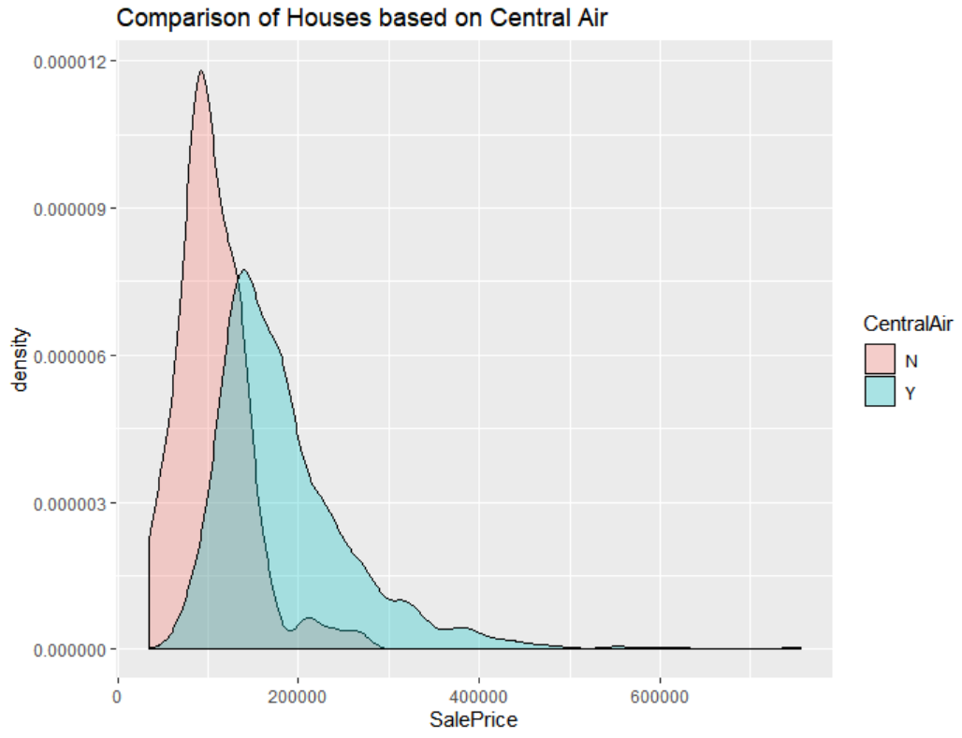
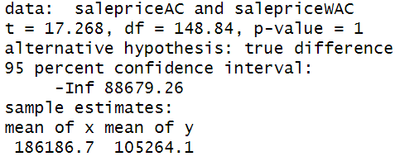
Comparison of Prices for Houses with and without Central AIR
Hypothesis Testing at 95% Confidence Interval
Null Hypothesis: Mean Prices of Houses with AC >= Mean Prices of Houses without AC
Alternate Hypothesis: Mean Prices of Houses with AC < Mean Prices of Houses without AC
Results:
Mean Prices of Houses with Central Air is Higher

Slide 10
House Price Predictions
What can be the potential cost of a house?

Slide 11
Predictive Analysis: Modelling Techniques
Linear Regression
Lasso Regression
Ridge Regression
Random Forest
Feature Importance: Overall Quality
Model Performance:
Feature Importance: Electrical Mix
Model Performance:
Feature Importance: Central Air
Model Performance:
Feature Importance: Overall Quality
Model Performance:
Parameter | Value
Training Error | 11%
RMSE | 10%
MAE | 7%
Accuracy | 93%
Time Run (in Seconds) | 0.08
Parameter | Value
Training Error | 11%
RMSE | 10%
MAE | 8%
Accuracy | 92%
Time Run (in Seconds) | 6.34
Parameter | Value
Training Error | 11%
RMSE | 10%
MAE | 7%
Accuracy | 93%
Time Run (in Seconds) | 5.48
Parameter | Value
Training Error | 3%
RMSE | 5%
MAE | 3%
Accuracy | 97%
Time Run (in Seconds) | 7.71

Slide 12
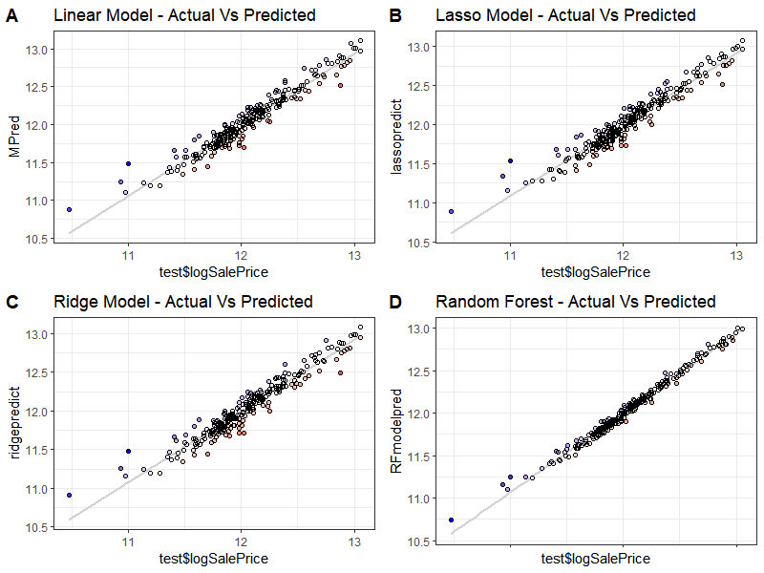
Graphical Comparison of the Predictions
Random Forest Modelling seems to work the best. It is clearly visible that predictions are more closer to the actual values using Random Foresting.
01
02
03
04
05

Slide 13
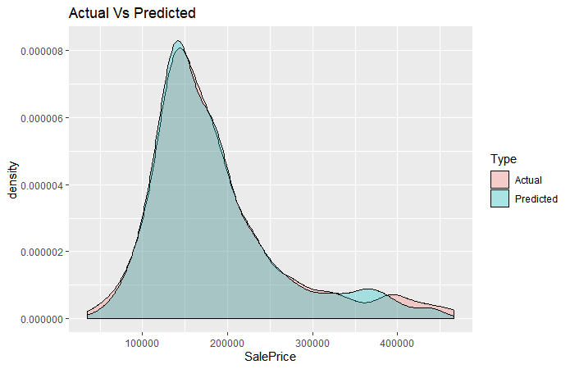
Random Forest Model Predictions
Parameter | Predicted | Actual | % Error
Mean | 184095.9 | 185819.2 | 0.93%
Std Dev. | 75492.46 | 80292.63 | 5.98%
Median | 164852.4 | 165000 | 0.09%
Min | 46245.77 | 35311 | 30.97%
Max | 444797.6 | 466500 | 4.65%
Range | 398551.8 | 431189 | 7.57%
1st Quar | 135231 | 135000 | 0.17%
3rd Quar | 209351 | 210000 | 0.31%

Slide 14
References
House Prices: Advanced Regression Techniques. (n.d.). Retrieved from: https://www.kaggle.com/c/house-prices-advanced-regression-techniques/overview
Hands-On Machine Learning for Algorithmic Trading. (n.d.). Retrieved from: https://learning.oreilly.com/library/view/hands-on-machine-learning/9781789346411/e17de38e-

